Slide 1
WEATHER HAZARDS
Basic Meteorology
Oklahoma Climatological Survey

Slide 2
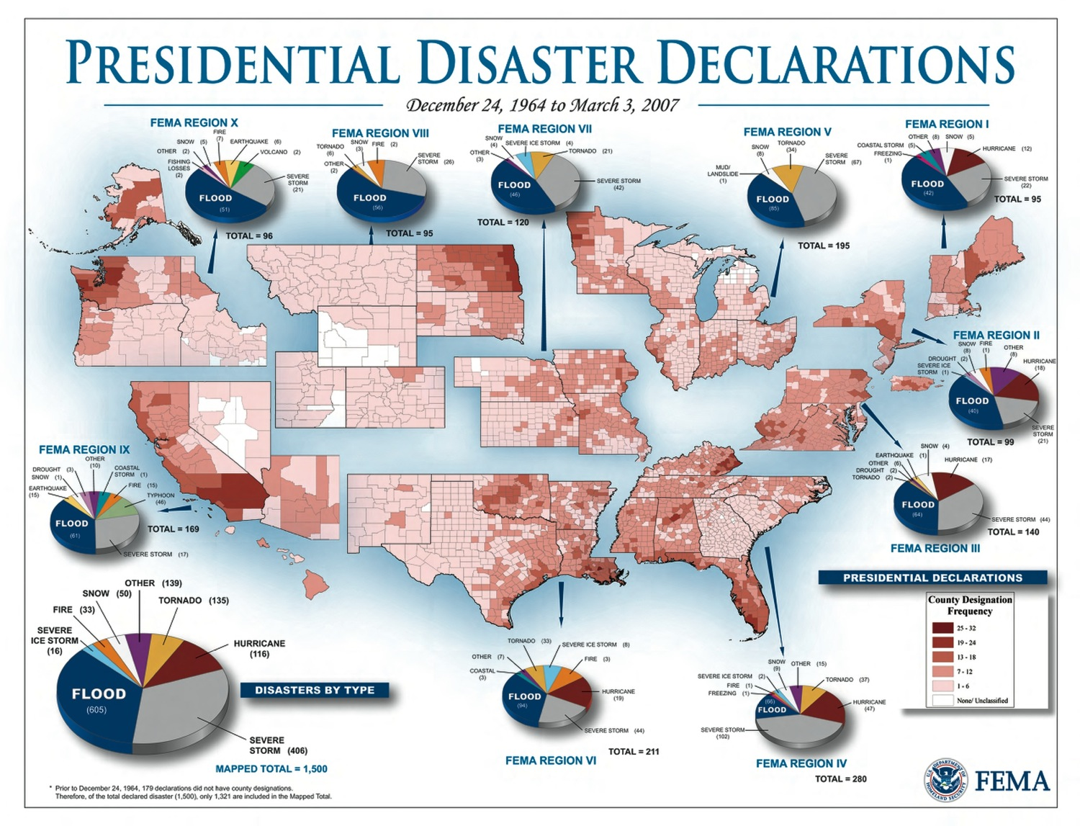

Slide 3
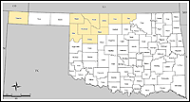
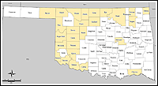
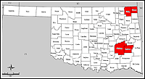
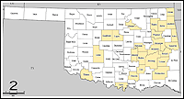
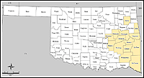
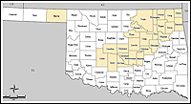
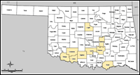
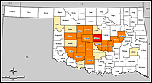
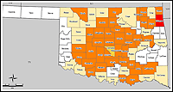
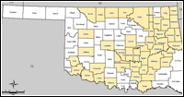
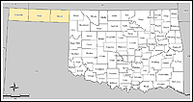
Recent Declared Disasters
1803 – Storms (Sep 08)
1775 – Floods (Jun 08)
1756 – Tornado (May 08)
1754 – Floods (Apr 08)
1752 – Floods (May 08)
1735 – Ice Storm (Dec 07)
1723 – Floods (May 07)
1718 – Storms (Aug 07)
1712 – Floods (Jun 07)
1707 – Floods (May 07)
1678 – Ice Storm (Jan 07)
1677–Snow Storm (Dec 06)

Slide 4
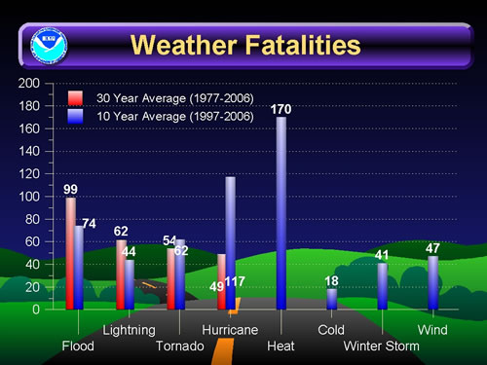
National Weather Fatalities
Graphic courtesy of NOAA

Slide 5
Thunderstorm Facts
Thunderstorms affect relatively small areas when compared to hurricanes & winter storms
  The typical thunderstorm is 15 miles in diameter & lasts an average of 30 minutes
Nearly 1800 thunderstorms are occurring at any moment around the world – 16 million a year!
  100,000 each year in the United States
  Of these, about 10% are severe
Thunderstorms are most likely to happen in the spring & summer months & during the afternoon & evening hours, but they can occur year-round & at all hours
Despite their small size, all thunderstorms are dangerous because they produce lightning, and also may generate heavy rain, strong winds, hail, & tornadoes

Slide 6
Outlooks, Watches and Warnings
Outlook
  Indicates that hazardous weather may develop – useful to those who need considerable lead time to prepare for a possible event
  Issued by National Weather Service (NWS) Office or Storm Prediction Center (SPC)
Watch
  Atmospheric conditions are right for hazardous weather – hazardous weather is likely to occur
  Issued by SPC
Warning
  Hazardous weather is either imminent or occurring
  Issued by local NWS office

Slide 7
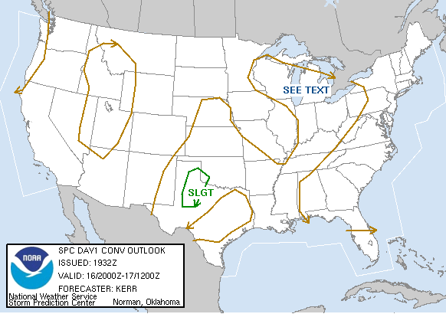
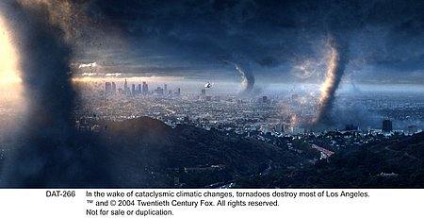
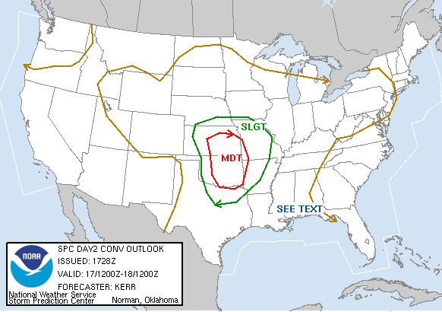
Outlooks—SPC
Storm Prediction Center (SPC) Outlook=Convective Outlook
Preview of the day’s chances for severe weather—hazardous weather that may develop
Day 1 = Today, Day 2 = Tomorrow, Day 3 = Day after tomorrow
Day 1
Day 3?
Day 2

Slide 8
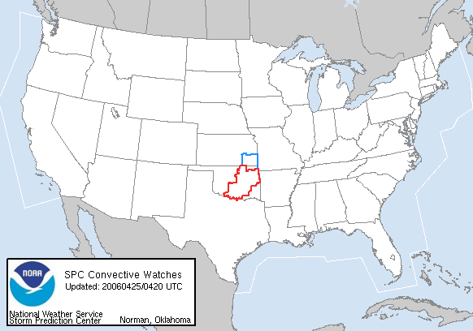
Watches
Conditions are favorable for a particular weather hazard within the next several hours
Clusters of counties
Issued by SPC

Slide 9
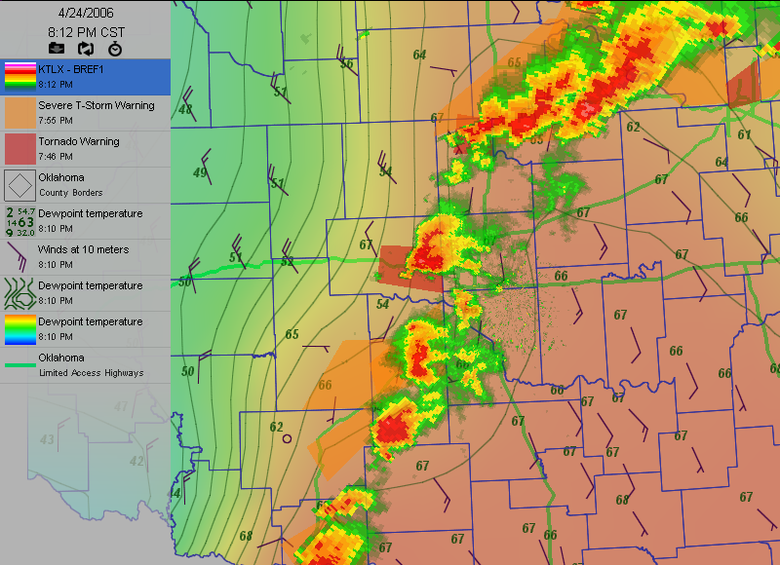
Warnings
Hazardous weather is
either imminent or
occurring
Small polygons
Issued by local NWS office
Area in IMMEDIATE
danger

Slide 10
What Is A Severe Thunderstorm?
Tornadoes
Wind Speeds greater than 57 mph
Hail greater than ¾-inch diameter
Lightning: no criteria
Heavy/Flooding Rainfall: no criteria
  Separate flood warnings may be issued

Slide 11
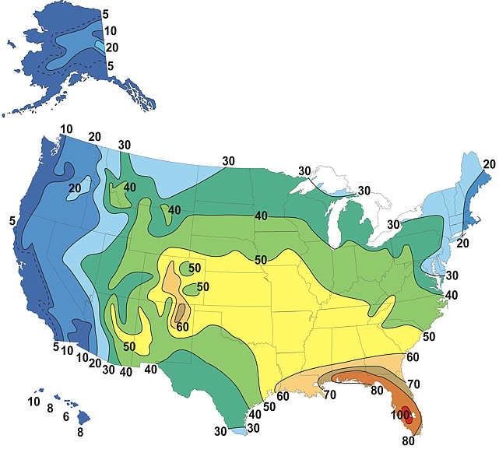
Severe Thunderstorm Climatology
Source: NOAA National Weather Service Jetstream

Slide 12
SEVERE THUNDERSTORMS

Slide 13
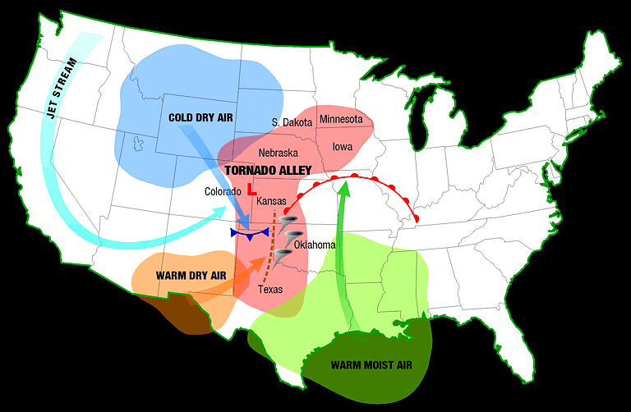
Tornadoes
A violently rotating column of air descending from a thunderstorm and in contact with the ground
  May have wind speeds over 300 mph
Usually brief, but may last more than an hour and travel for tens of miles
Nearly 1,000 tornadoes occur in the U.S. each year, with an average of 62 fatalities
  Most occur across the plains and South
Rotation in the mesocyclone causes a hook-shaped feature on radar that may help identify regions favorable for a tornado to form
Source: NOAA National Severe Storms Laboratory

Slide 14
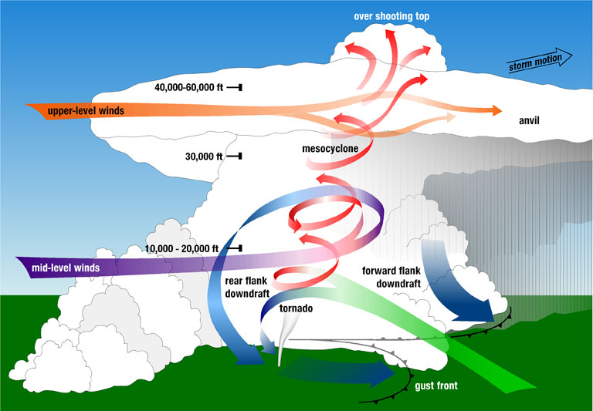
How Do Tornadoes Form?
Wind Shear in the atmosphere causes rotation
  Changes in direction and speed with height
The horizontal rotation created by the wind shear gets tilted vertically into the updraft
  The rotation in the parent thunderstorm is called a mesocyclone
  The rotating mesocyclone often appears as a ‘hook’ shape on radar
Convergence of surface winds underneath the updraft enhance rotation at lower levels, creating a tornado
  rotation may be aided by a rear flank downdraft of descending air near the updraft that enhances convergence
  Fewer than 20% of supercell thunderstorms actually produce tornadoes!
Source: NOAA National Severe Storms Laboratory

Slide 15
Enhanced Fujita (EF) Scale
F Number | Wind Speed (mph)* | EF Number | Wind Speed (mph)*
F0 Weak | 45-78 | EF0 | 65-85
F1 Weak | 79-117 | EF1 | 86-109
F2 Significant/ Strong | 118-161 | EF2 | 110-137
F3 Significant/ Strong | 162-209 | EF3 | 138-167
F4 Significant/ Violent | 210-261 | EF4 | 168-199
F5 Significant/ Violent | 262-317 | EF5 | 200-234
*Estimated

Slide 16
Tornado Strength
2%
3%
29%
27%
69%
70%
Number of Tornadoes
by F-scale
Tornadoes Deaths
by F-scale

Slide 17
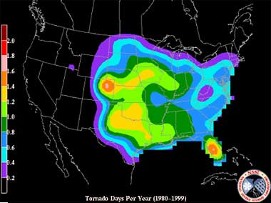
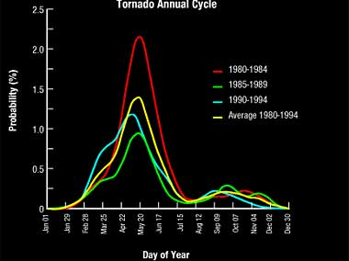
Where and When Do They Occur?
Source: NOAA National Severe Storms Laboratory
Source: NOAA National Severe Storms Laboratory

Slide 18
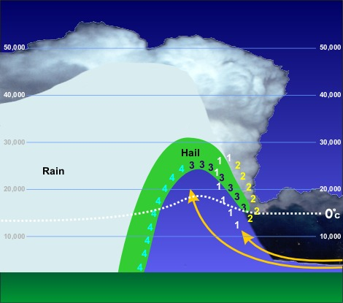
Hail
Hail forms by collision of supercooled drops – raindrops that are still liquid even though the air around them is below freezing
The hailstone continues to grow, supported by the updraft, until it is too heavy to remain aloft
  The stronger the updraft, the bigger the hail size
Large hail occurs most frequently in the great plains, but can occur anywhere
Causes $1 billion damages yearly, but few fatalities
Source: NOAA National Weather Service Jetstream

Slide 19
Hail Size
Hailstone size | Measurement |  | Updraft Speed
 | in. | cm. | mph | m/s
bb | < 1/4 | < 0.64 | < 24 | < 11
pea | 1/4 | 0.64 | 24 | 11
marble | 1/2 | 1.3 | 35 | 16
dime | 7/10 | 1.8 | 38 | 17
penny | 3/4 | 1.9 | 40 | 18
nickel | 7/8 | 2.2 | 46 | 21
quarter | 1 | 2.5 | 49 | 22
half dollar | 1 1/4 | 3.2 | 54 | 24
walnut | 1 1/2 | 3.8 | 60 | 27
golf ball | 1 3/4 | 4.4 | 64 | 29
hen egg | 2 | 5.1 | 69 | 31
tennis ball | 2 1/2 | 6.4 | 77 | 34
baseball | 2 3/4 | 7.0 | 81 | 36
tea cup | 3 | 7.6 | 84 | 38
grapefruit | 4 | 10.1 | 98 | 44
softball | 4 1/2 | 11.4 | 103 | 46

Slide 20
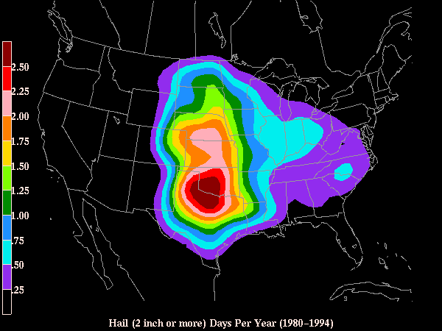
Where Does Hail Occur?
Source: NOAA National Severe Storms Laboratory

Slide 21
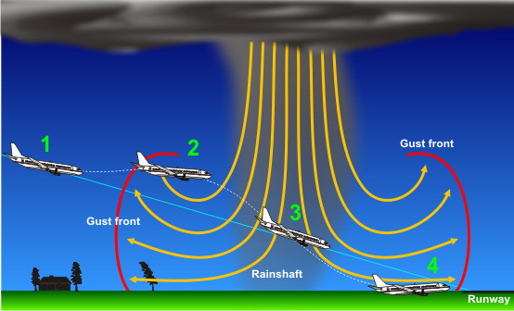
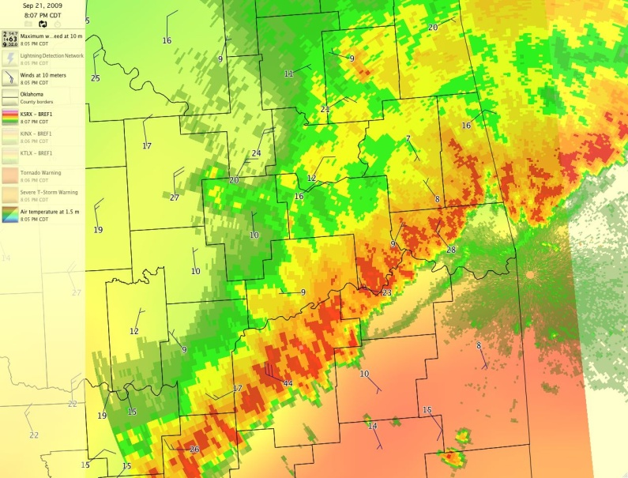
High Winds
Responsible for most thunderstorm damage
  Much larger area affected than tornado paths
Winds may exceed 100 mph
Downdraft originates as rain falls, pulling air downward
  Evaporative cooling accelerates downdraft
Air spreads out horizontally when it hits the ground, creating gust fronts
Most often associated with squall lines or supercells (microbursts)
Average 47 fatalities annually
Source: NOAA National Weather Service Jetstream

Slide 22
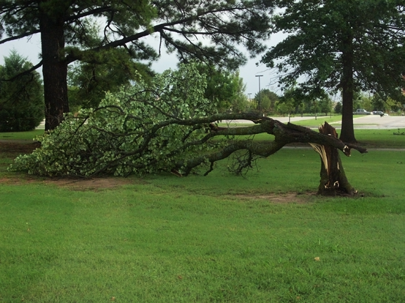
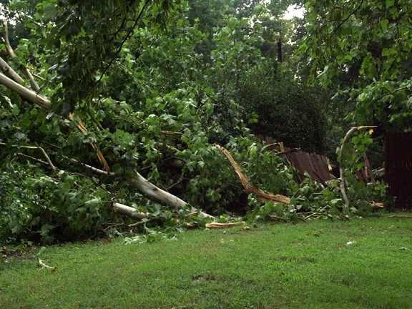
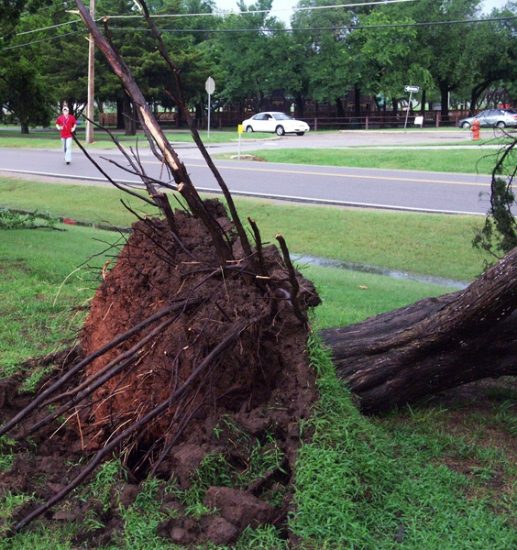
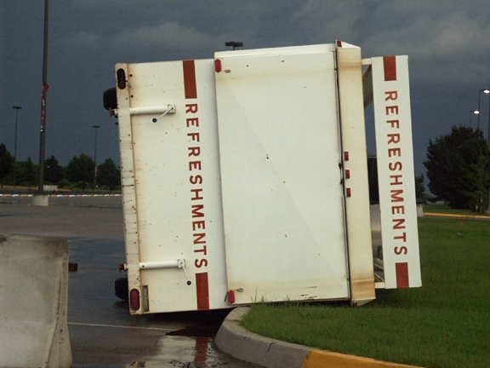
Microburst Damage July 2007, Norman, OK

Slide 23
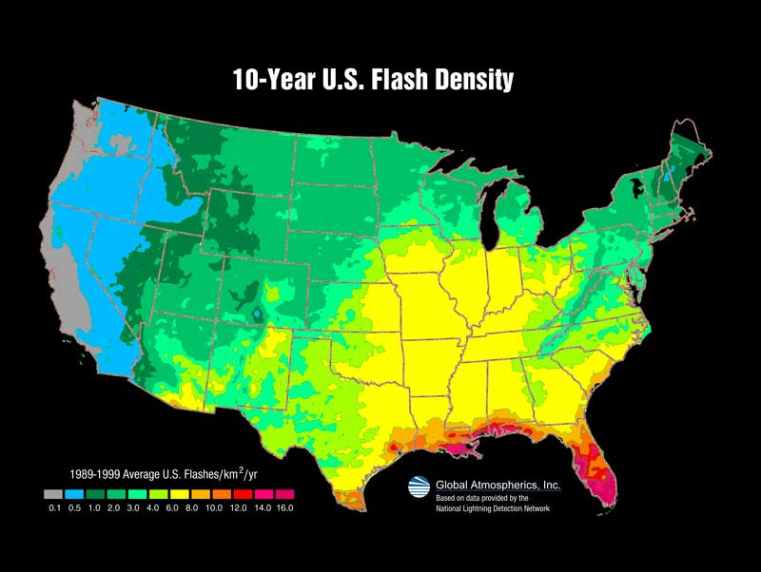
Lightning
Lightning is essentially a large spark of static electricity
  Like when you touch a doorknob on a dry day
Lightning occurs about 40 times per second, worldwide, in about 2,000 thunderstorms simultaneously
Lightning strikes about 400 people in the U.S. each year, killing 58
  Many victims are caught outdoors
  Lightning can travel along telephone lines, pipes, tree roots, and other good conductors
Lightning can strike well away from the storm, as far as 10 miles
Source: NOAA National Severe Storms Laboratory

Slide 24
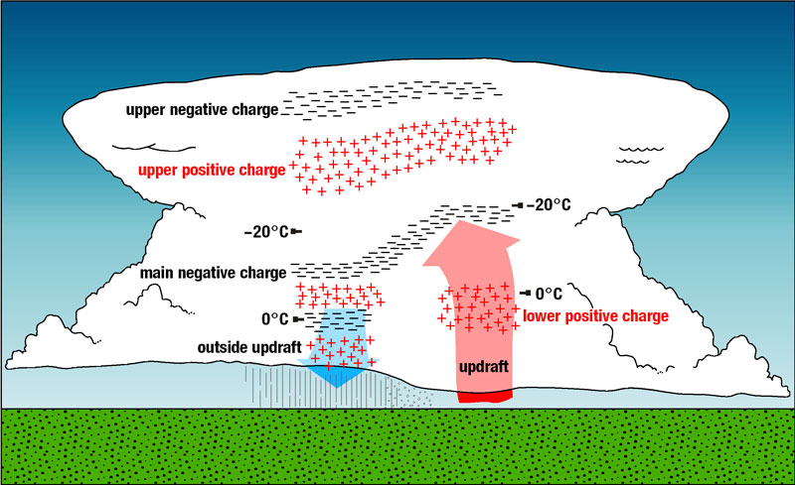
How Lightning is Created
Collisions between cloud droplets, hail, and ice nuclei create free electrons which are separated in the storm through updrafts and downdrafts
  Positive charge accumulates near the storm top, negative charge near the bottom
  These separate charge centers create an electric field between them
When the strength of the electric field exceeds the insulating properties of the atmosphere, a breakdown occurs, which we see as lightning
The negative charge center at the base of the storm induces a positive charge in the ground
  The field between the charge centers in the cloud is greater than the field between cloud and ground, so 75-80% of lightning occurs within the cloud rather than cloud-to-ground
Source: NOAA National Severe Storms Laboratory

Slide 25

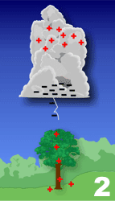
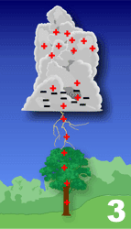
Cloud-to-Ground Lightning
  Negative charge descends from the cloud in a series of stepped leaders
  As it nears the ground, the positive charge sends up a streamer
  When the streamer connects to the stepped leader, an electrical circuit is created which transfers charge between the two charge centers in a return stroke, which we see as lightning
  If additional charge remains, additional return strokes may occur, which gives lightning a flickering effect
  Although lightning is attracted toward taller objects (shortest path), it may strike other objects nearby
    less air resistance
    Sharp points tend to concentrate charge, building up a larger electric field
    Branches off the main channel
Source: NOAA National Weather Service Jetstream

Slide 26
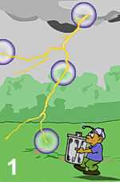
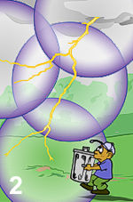
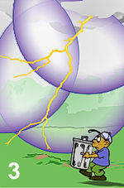
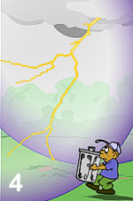
What Makes Thunder
Thunder is a shock wave created by the rapid expansion of air in the lightning channel
  Lightning heats the air to 18,000°F – hotter than the surface of the sun!
The “crackle” you may hear before the main “boom” is from the stepped leaders and ground streamer
The rumble you hear is due to different times-of-arrival of the shock wave from different parts of the lightning channel
  Parts of the channel near the cloud base are further away from you than parts near the ground
Light travels about 186,000 miles per second (670 million miles per hour) while sound travels only 0.2 miles per second (750 mph)
  Consequently, the flash is instantaneous and the time it takes to hear the thunder can determine its distance
  Count the seconds between the flash and the sound of thunder; for roughly every 5 seconds, the strike is one mile away
Know the 30/30 rule: seek shelter if the time from flash-to-bang is less than 30 seconds and remain inside for 30 minutes until after the last thunder is heard
Source: NOAA National Weather Service Jetstream

Slide 27
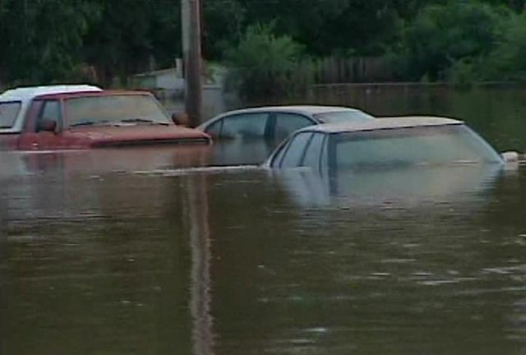
Flooding
Flooding causes an average 127 deaths per year
  As little as 6 inches of moving water can sweep a person away
  Nearly half these deaths are vehicle-related; two feet of water can float a vehicle
Primary causes:
  Slow-moving thunderstorms
  Training echoes – a series of storms tracking over the same location
  Tropical systems
If ground is saturated from previous rainfall, a less-intense storm can cause flooding
Extended periods of rain can result in river flooding
  Water rises more slowly but flooding may last for days or weeks
Graphic courtesy of KOTV, Tulsa, OK
(Tropical Storm Erin flooding)

Slide 28
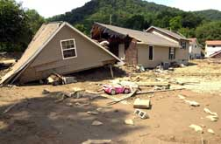
Flash Flooding
Flash floods occur with little or no warning!
Flash floods are capable of:
  Moving large objects like boulders
  Tearing out trees
  Destroying buildings or bridges
  Scouring new channels
  Creating mud slides
Rocky areas or very dry soils may behave like concrete, with very little rainfall soaking in and most running off into streams
Photo by Leif Skoogfors/ FEMA

Slide 29
Flash Flooding
Areas most susceptible to flash floods:
  Low-lying areas (water runs downhill)
  Urban areas
  Underpasses
  Dry creek beds or near the banks of streams & rivers
  Canyons: a creek only 6 inches deep can become a 10-foot-deep raging river in less than an hour
  Downstream of a dam or levee
  Downstream of an ice jam
  Upstream from a bridge
  Recent burn areas
Be prepared when hiking or camping
  Watch for signs of thunderstorms, especially in upstream areas
  If at all possible, carry a device capable of checking weather alerts, such as a NOAA Weather Radio, cell phone, or pager
  If water starts rising, seek high ground immediately
  Even if it is not raining where you are, water can come downstream quickly

Slide 30
The 100-year Flood
The “100-year flood” is a one percent probability that a flood of a certain magnitude will occur
  50-year flood: expected to occur once every 50 years, or a 2% chance in any given year
  25-year flood: expected to occur once every 25 years, or a 4% chance in any given year
An event is equally likely to occur at any time
  Just because the 100-year flood occurred last year does not mean it will not happen this year
  Can have occurrences in successive years, or even multiple occurrences in a single year!
Based on prior events – their frequency and magnitude
  In fact, once the event is added into the statistics, it becomes more likely (statistically-speaking) that the event will occur again, because you now have 2 events at the extremes
Factors other than rainfall change the areas susceptible to flooding
  Upstream development / more concrete increases runoff
  Changes in land features & ecosystems
  Climate changes: storms may be different now from what they were 25 or 50 years ago

Slide 31
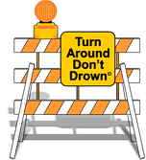
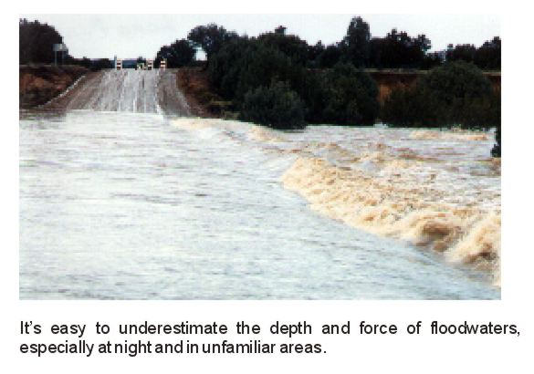
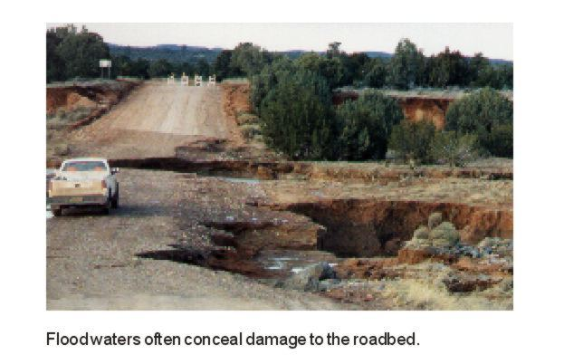
Flooding—Turn Around, Don’t Drown
National Weather Service slogan for flooding dangers
Why should you not go through water on the roadway?

Slide 32
OTHER WEATHER HAZARDS

Slide 33
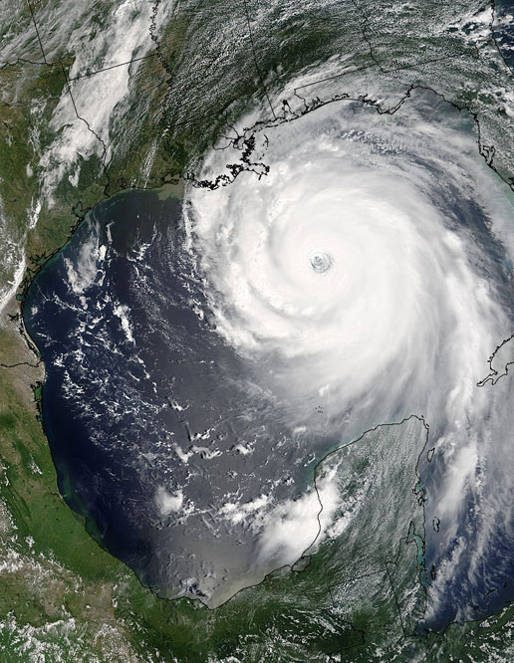
Tropical Cyclones
While not much of a direct hazard in Oklahoma, their impacts can affect our state
Main threats:
  Storm surge: “pushes” ocean water against the coast raising water level by 15 feet or more
  Winds: Sustained winds over 160 mph with gusts over 200 mph recorded in the most intense hurricanes
  Inland flooding: tropical rains may drop several feet of rain in a few days; 60% of deaths are related to inland flooding
  Tornadoes: Often occur in the right-front quadrant of the storm, embedded in rainbands
Ingredients for formation:
  Warm ocean waters (80°F)
  Unstable atmosphere
  Moist air throughout the troposphere
  Pre-existing surface disturbance
  Very little vertical wind shear
  At least 300 miles from the equator (5° latitude)
Given different names around the world: hurricane, typhoon, tropical cyclone
Source: NASA (Hurricane Katrina)

Slide 34
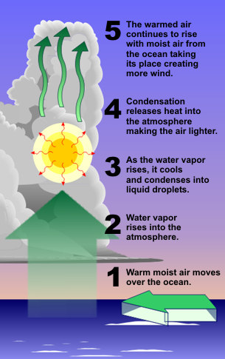
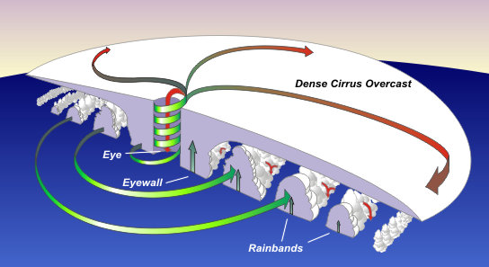
Tropical Cyclones Structure
Tropical cyclones form as air rises from a warm ocean surface
  Condensation releases heat which adds to the strength of the updraft
Air spirals inward toward the circulation center (surface low pressure), creating spiral rainbands
As air nears the center, centrifugal force counteracts the pressure gradient force, forming an area ~20-40 across, where rising motion ceases
  Air in the center is replaced by sinking air from the top of the storm, creating an eye (descending air warms and dries)
Tropical storm winds extend outward about 300 miles in mature hurricanes
  the largest on record was 675 miles across; the smallest just 30
Source: NOAA National Weather Service Jetstream

Slide 35
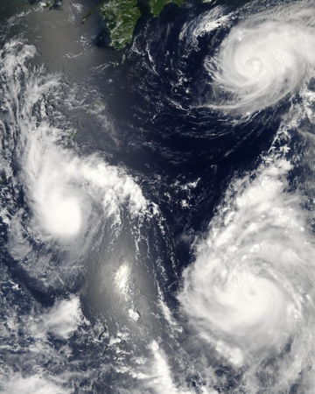
Tropical Cyclones Stages
Hurricanes go through stages of growth:
  Tropical Depression: circulation with sustained wind speeds of up to 38 mph (storm not yet named)
  Tropical Storm: sustained wind speeds 39-73 mph (the storm receives a name)
  Hurricane: sustained wind speeds of 74 mph or greater
Hurricanes are further assigned a category (1-5) based on their sustained wind speed
  Category 1: 74-95 mph; little damage
  Category 2: 96-110 mph; roof and tree damage
  Category 3: 110-130 mph; some structural damage; storm surge up to 12 feet
  Category 4: 131-155 mph; widespread damage, some structural failure; storm surge to 18 feet
  Category 5: >155 mph; complete structural failures; storm surge greater than 18 feet
Category 3-5 is considered a “major hurricane”
  These account for 83% of damage, but are only 21% of landfalling (U.S.) hurricanes
When hurricanes make landfall, two things happen:
  They lose their source of energy – conversion of warm, moist ocean air into heat that sustains the updrafts
  Friction increases, slowing wind speeds and allowing more convergence of air into the center
Source: Wikipedia / NASA

Slide 36
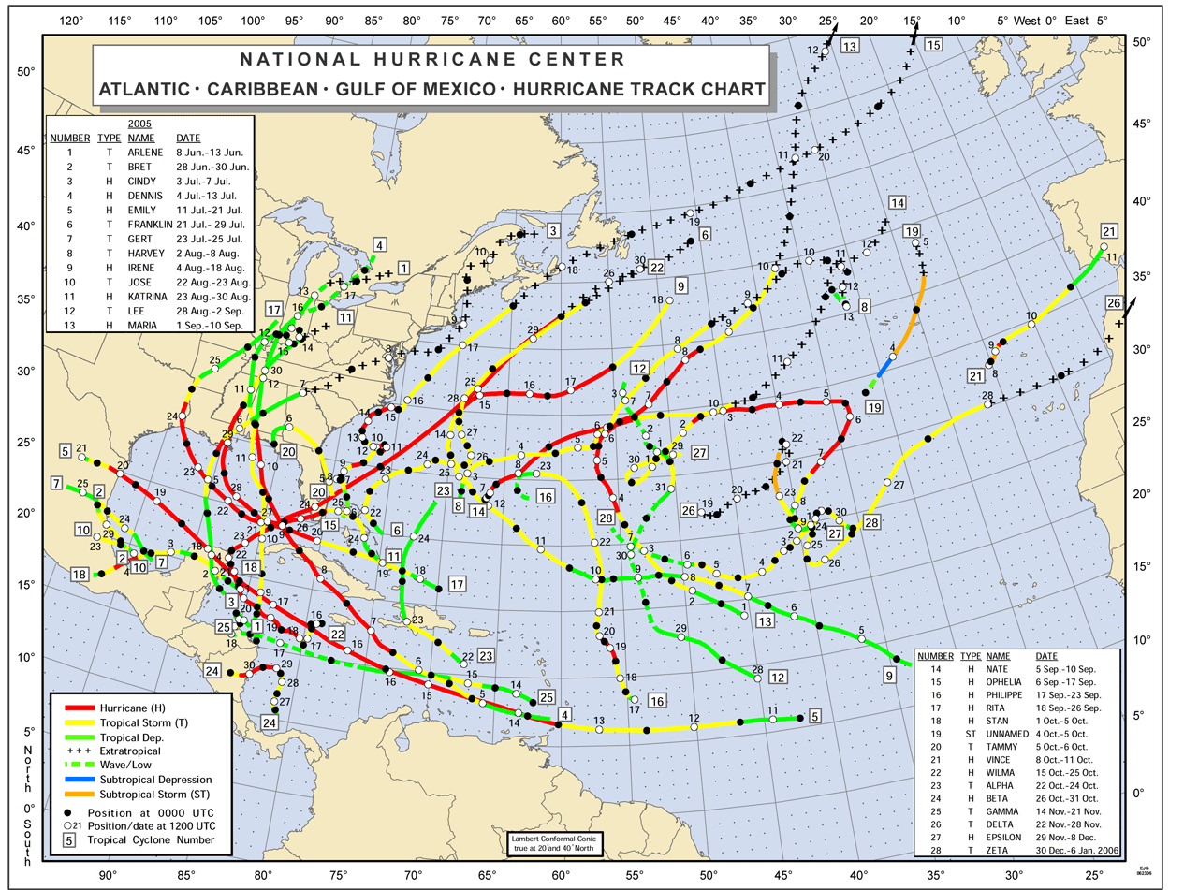
Hurricane Tracks (2005)

Slide 37
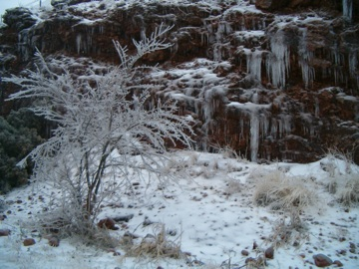
Winter Storms
All winter storms are basically regular storms but in a cold environment
Ingredients (sound familiar?):
  Moisture
  Instability
  Lift
  + Cold layer through which precipitation falls
Dangers
  Snow squalls: brief intense periods of snow can cause ‘white out’ conditions
  Blowing snow: reduces visibility and creates drifts
  Blizzard: winds over 35 mph with snow falling, reducing visibility to ¼ mile or less for at least 3 hours
  Avalanche: heavy snow in mountains can slide downhill, collecting more snow along the path
Most risks are not directly related to the storm:
  Traffic accidents (70% of fatalities)
  Hypothermia from prolonged exposure to the cold (25% of fatalities)
  Falling on the ice
  Heart attacks while shoveling snow / clearing debris
  Falling tree limbs, power lines, or falling ice

Slide 38



Types of Winter Storms
Snow
  Ice crystals form in the cloud and stick together, making snowflakes
  Cold throughout the depth of the storm
Sleet
  An intervening layer of warm air between the cloud and surface
  Some snow melts and then re-freezes before reaching the ground
  Results in a combination of snow and ice pellets
Freezing Rain
  Deeper warm layer; snow melts completely
  Falls into shallow cold layer at surface where it becomes supercooled
  Does not have time to re-freeze (like sleet)
  Freezes on contact with below-freezing surfaces (roads, trees, cars, …)
Thundersnow
  Simply a thunderstorm in cold air
  Still has convective properties (updraft, charge separation)
  Can occur with any of these types

Slide 39






Winter Storm Oklahoma,
9-10 December 2007

Slide 40


Wind Chill
Wind blows heat away from your body
  Shortens the amount of time needed to cool
  Wind chill is based on the rate of heat loss due to wind on exposed skin
Risks of extreme cold are increased
  Frost bite occurs when tissue (skin) freezes; most commonly extremities such as toes, fingers, ears, or nose
  Hypothermia occurs when the body temperature drops below 95°F
It will not reduce inanimate objects (like pipes) to that temperature
Stay Warm:
  Wear layers (traps heat)
  Avoid sweating (evaporation)
  Cover head (50% of heat loss)
  Cover mouth (protect lungs)

Slide 41

Extreme Heat
Heat waves are the #1 weather-related killer in the United States
  Responsible for an average of 170 deaths per year
Effects are increased in urban areas
  Concrete absorbs and retains heat very efficiently
  Does not cool down much at night; body does not get relief
  Some urban heat events have killed thousands
Heat is dissipated through radiation, convection, or evaporation
  At lower temperatures, radiation and convection efficiently dissipate heat
  Above 95 degrees (air temperature), these no longer work, so we sweat in order to cool by evaporation
“At risk” populations include the elderly, children, and sick people, but even healthy people may succumb to the heat
Source: NOAA National Weather Service Jetstream

Slide 42

Heat Index
It’s not the heat, it’s the humidity
  Well, actually it’s both!
High humidity retards evaporation, so dissipation of heat through sweating is less effective
The apparent temperature, or heat index, is based on a combination of temperature and humidity
  The equivalent of what the temperature would have to be if humidity was negligible
  Based on shady areas, light winds; full sunshine and/or strong winds can add 15 degrees to this
Prolonged exposure can lead to heat cramps, heat exhaustion, or heatstroke

Slide 43

Heat Index Chart
Severe heat disorders are likely with continued exposure
Graphic courtesy of the NWS

Slide 44


Heat Index in Oklahoma
Actual Temperature
Heat Index

Slide 45

Drought
Persistent period of unusually dry weather that leads to impacts on crops and/or water supplies
May be severe short-term effects or prolonged, extended droughts
  “agricultural drought” – usually shorter term, affecting crop growth & pastures
  “meteorological drought” – extended period of below-normal precipitation
  “hydrologic drought” – prolonged dryness affecting streams, lakes, and ground water supplies
  “socio-economic drought” – impacts causing severe economic losses and/or social disruptions
Associated hazards:
  Heat waves
  Wild fires
  Expansive soils
Source: NASA Earth Observatory

Slide 46
Multiple competing values, Multiple competing objectives
Power
generation
Ecosystems
health
Recreation
Consumptive
use
Flood
control
Agriculture
Source: Roger Pulwarty, NIDIS

Slide 47

Droughts are a part of Oklahoma

Slide 48

Wildfires
Over 140,000 wildfires occur each year in the U.S., destroying 900 homes on average
Key ingredients:
  Low humidity
  Relatively high temperatures (large difference between temperature and dewpoint; actual temperature less of a factor)
  Moderate to strong winds, gusty
  Dry fuels (leaves, twigs, vegetation)
These conditions can happen at nearly any time
  It does not take months or even weeks of dry weather to create explosive conditions
  Most common conditions from late fall – early spring in the Southern Plains
The urban-wildland interface is particularly susceptible
  Development in formerly-prairie or woodland areas puts homes close to potential fire fuels
  Outlying areas may lack fire-fighting capacity (fire hydrants, limited access to vehicles)
Source: NOAA

Slide 49


Protecting Yourself From Wildfires
Outdoors:
  Build fires away from nearby trees or bushes.
  Always have a way to extinguish the fire quickly and completely.
  Never leave a fire burning unattended.
  Avoid open burning completely, and especially during dry season.
Around Your Home:
  Create a survivable space around your home; an irrigated area near the home, low-growing plants and shrubs further away, clear away dead branches and prune low branches, thin highly flammable vegetation
  Install fire-resistant roofing materials; hot embers (firebrands) can be blown from a nearby fire onto your roof
  Vents and chimneys should be screened
  Clear any debris beneath decks; box them with fire-resistant materials
  Make sure roads are clearly marked so fire vehicles can get to your home easily
Source: Kelly Hurt, Arkansas Firewise

